Slide 1
Regression Analysis
Logistic Regression
Nicoleta Serban, Ph.D.
Professor
Stewart School of Industrial and Systems Engineering
Case Study: The Demographics of Obesity

Slide 2

About This Lesson

Slide 3
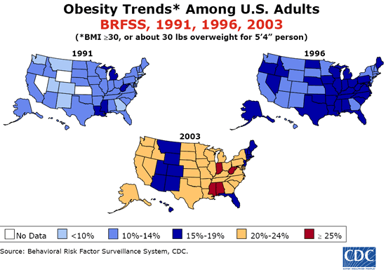
Obesity in the United States
Notes:
Body Mass Index (BMI) Score created from height and weight
Obesity: A BMI score of greater than or equal to 30
Causes incredible health problems that strain health systems and are preventable

Slide 4
Case Study Overview
Objective:
Use National Health and Nutrition Examination Survey (NHANES) to create a model used to predict likelihood of obesity.
Identify predicting factors with predictive power
Variables:
Response Variable: Whether an adult is classified as obese
Predicting Variables: Age, Education Level, Gender
Training Data (4,314 Observations)
Data
Testing Data (1,000 Observations)

Slide 5
Case Study Overview
Objective:
Use National Health and Nutrition Examination Survey (NHANES) to create a model used to predict likelihood of obesity.
Identify predicting factors with predictive power
Variables:
Response Variable: Whether an adult is classified as obese
Predicting Variables: Age, Education Level, Gender
Age variable
Present as a continuous variable in the data
Recoded into classes (or ranges) like
  Class 1: 18-24 years
  Class 2: 25-34 years
  etc.
Training Data (4,314 Observations)
Data
Testing Data (1,000 Observations)

Slide 6
Obesity Data
## Read data in R
obdata = read.table("obesitydata.txt", h=T)
attach(obdata)
## Data before aggregation
obesityind = factor(Obesity, labels=c("NotObese", "Obese"))
agegr = factor(AgeGroup,
labels=c("18to24", "25to34", "35to44", "45to64", "65+"))
gender = factor(Gender, labels=c("Male", "Female"))
edu = factor(Education,
labels=c("<9thGrade", "9to11Grade", "HighSchool", "SomeCollege", "College+"))

Slide 7
Exploratory Data Analysis
## Exploratory data analysis: Categorical Predictors
tb_ageedu = xtabs(~agegr+edu)
library(vcd)
mosaicplot(tb_ageedu, xlab="Age Group", ylab="Education", color=TRUE, main="")

Slide 8
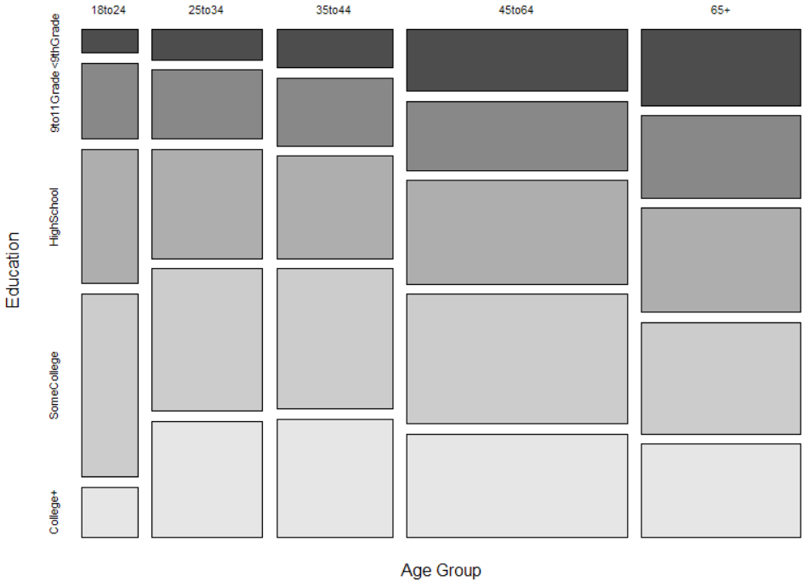
Exploratory Data Analysis

Slide 9
Exploratory Data Analysis
## Exploratory data analysis: Response vs Predictors
tb_obage = xtabs(~obesityind+agegr)
tb_obgender = xtabs(~obesityind+gender)
tb_obedu = xtabs(~obesityind+edu)
barplot(prop.table(tb_obage), axes=T, space=0.3, horiz=T,
xlab="Proportion of Not Obese (blue) vs Obese (Brown)",
col=c("blue","brown"), main="Obesity by Age Group")
barplot(prop.table(tb_obgender), axes=T, space=0.3, horiz=T,
xlab="Proportion of Not Obese (blue) vs Obese (Brown)",
col=c("blue","brown"), main="Obesity by Gender")
barplot(prop.table(tb_obedu), axes=T, space=0.3, horiz=T,
xlab="Proportion of Not Obese (blue) vs Obese (Brown)",
col=c("blue","brown"), main="Obesity by Education Level")

Slide 10
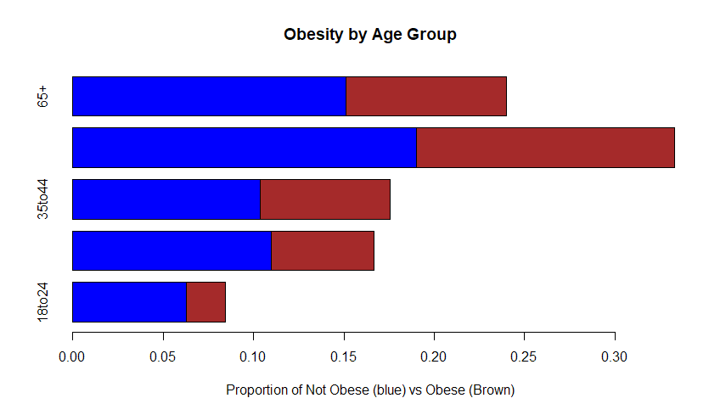
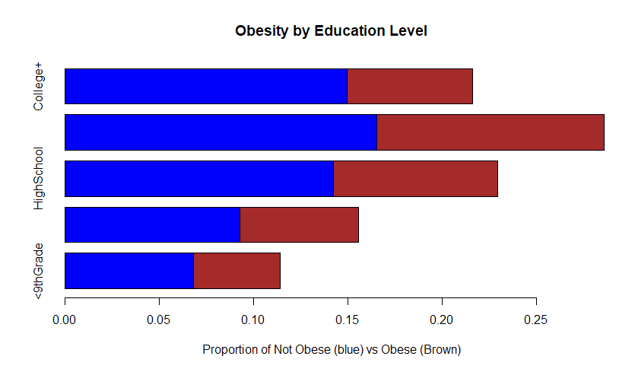
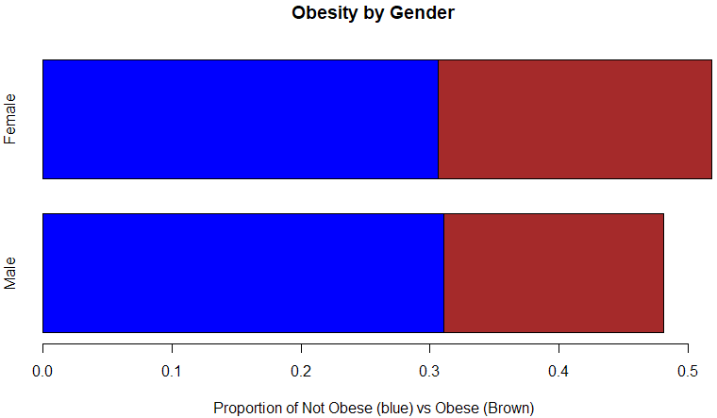
Exploratory Data Analysis

Slide 11

Summary

